Slide 1
CHAPTER 7
PERCEPTION

Slide 2
Objectives
Factors influencing perception
Attribution theory
Identify the barriers to perception
State the specific applications in organizations
Decision making process

Slide 3
Introduction:
Perception is one of the oldest fields in psychology.
The word "perception" comes from the Latin words perceptio, percipio which means :receiving, collecting and action of taking possession with the mind or senses.
Individuals behave in a given manner based not on the way their external environment actually is, but rather on what they see or believe it to be.

Slide 4
What Is Perception, and Why Is It Important?
Processes, by which individuals select, organize, interpret and respond to information from the world around them.
This information is gathered from the five senses – sight, hearing, touch, taste and smell.
It presents the psychological process whereby people take information from the environment and make sense of their world.
So, we can say perception in one word means sensing.

Slide 5
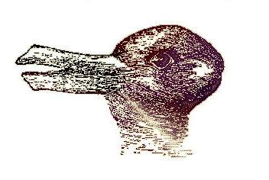

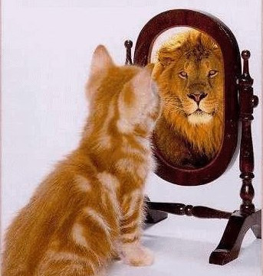
Face or Vase?
Duck or Rabbit??

Slide 6
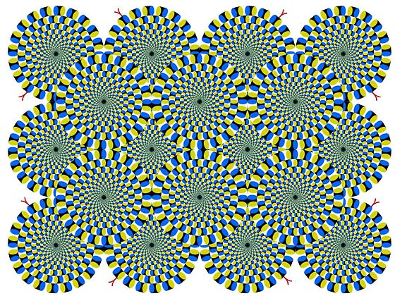
Motion Perception…right side turn or??

Slide 7
Factors Influencing Perception
  Perceiver : one who perceives
  Target : object or person being perceived
  Situation: Context in which the perception is made.

Slide 8
Factors That Influence Perception
Factors in the perceiver
Attitudes
Motives
Interests
Experience
Expectations
Factors in the situation
Time
Work setting
Social setting
Perception
Factors in the target
Novelty
Motion
Sounds
Size
Background
Proximity
Similarity

Slide 9
Person Perception: Making Judgments About Others
ATTRIBUTION THEORY
  It refers simply to how people explain the cause of another’s or their own behaviour. It is the cognitive process by which people draw conclusions about the factors that influence, or make sense of one another’s behaviour. When individuals observe behaviour, they attempt to determine whether it is internally or externally caused (locus of control). They perceive that locus of control may have a differential impact on their performance and satisfaction.
  Distinctiveness: shows different behaviors in different situations.
  Consensus: response is the same as others to same situation.
  Consistency: responds in the same way over time.

Slide 10
Observation
Interpretation
Attribution of cause
Internal
Distinctiveness
External
Internal
Consensus
Individual Behaviour
External
Internal
Consistency
External

Slide 11
ERRORS AND BIASES IN ATTRIBUTIONS
FUNDATMENTAL ATTRIBUTION ERROR
  The tendency to underestimate the influence of external factors and overestimate the influence of internal factors when making judgments about the behaviour of others.
  E.x.: if a person is late at work, observers are more likely to conclude that the person is lazy than to think that external factors may have caused the behaviour. We do not give equal weight to both the person and the environment in judging others.

Slide 12
SELF-SERVING BIAS
  The tendency for individuals to attribute their own successes to internal factors while putting the blame for failures on external factors.
  e.g.: if explaining their victories, athletes commonly credit themselves but they are more likely to attribute losses to something else.

Slide 13
FREQUENTLY USED SHORTCUTS IN JUDGING OTHERS
Selective Perception
  People selectively interpret what they see on the basis of their interests, background, experience and attitudes.
  We see what we want to see and draw unwarranted conclusions from ambiguous situations.

Slide 14
Halo Effect
  Drawing a general impression about an individual on the basis of a single characteristic. It blinds the perceiver to other attributes that also should be evaluated to obtain a complete, accurate impression of the other person.
  e.g.: an excellent attendance record may produce judgments of high productivity, quality work and industriousness, whether they are accurate or not.
Contrast Effects
  Evaluation of person’s characteristics that are affected by comparisons with other people recently encountered who work rank higher or lower on the same characteristics.

Slide 15
4. Projection
  It refers to attributing one’s own characteristics to other people. It may be especially strong for undesirable traits that perceiver possess but fail to recognize in themselves.
5. Stereotyping
  Judging someone on the basis of one’s perception of the group to which that person belongs. We develop social categories and assign traits that are difficult to observe. Then they assign people to one or more social categories on the basis of easily observable information about them and lastly assign the cluster of traits linked to the social category of people identified as member of that group.
  e.g.: a number of male managers think that women are not interested in overseas assignment or jobs and won’t be effective in their work.
  6. First-impression error

Slide 16
Specific Applications In Organizations
Employment Interview
  Perceptual biases affect the accuracy of interviewers’ judgments of applicants.
  Different interviewer see different things in the same candidate as a result have a different conclusion.
Performance Expectations
  Self-fulfilling prophecy (Pygmalion effect): A positive instance of the self-fulfilling prophecy, in which people holding high expectations of another tend to improve that individual’s performance.
  Golem effect: A negative instance of the self-fulfilling prophecy, low expectations of another tend to lower that individual’s performance.

Slide 17
Performance Evaluations
  Appraisals represents an assessment of an employee’s work.
  Appraisals are subjective (judgmental) perceptions of performance.
Employee Effort
  Assessment of individual effort is a subjective judgment subject to perceptual distortion and bias.

Slide 18
The Link Between Perceptions And Individual Decision Making
PROBLEM
A discrepancy between some current state of affairs and some desired state.
Perceptions of the decision maker
DECISIONS
The choices made from among two or more alternatives.
Outcomes

Slide 19
Steps in the Rational Decision-Making Model
Define the problem.
Identify the decision criteria.
Allocate weights to the criteria.
Develop the alternatives.
Evaluate the alternatives.
Select the best alternatives.

Slide 20
Rational Decision-Making Model
A decision-making model that describes how individuals should behave consistently in order to maximize outcomes within specified constraints.
  Problem clarity
  Known options
  Clear preferences
  Constant preferences
  No time or cost constraints
  Maximum payoff

Slide 21
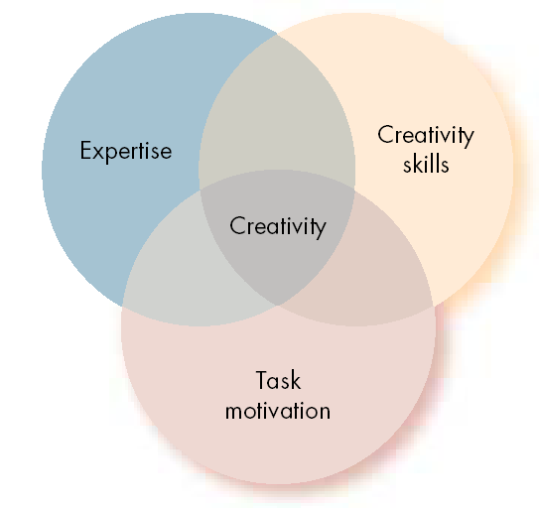
THE THREE COMPONENTS OF CREATIVITY
CREATIVITY
The ability to produce novel and useful ideas.
THREE-COMPONENT MODEL OF CREATIVITY
Proposition that individual creativity requires
expertise,
creative-thinking skills, and
intrinsic task motivation.

Slide 22
How Are Decisions Actually Made in Organizations?
Bounded Rationality
Individuals make decisions by constructing simplified models that extract the essential features from problems without capturing all their complexity.

Slide 23
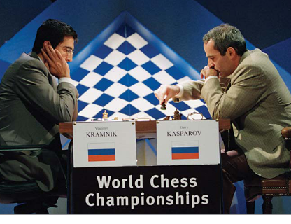
Intuition
Intuitive Decision Making
  An unconscious process created out of distilled experience.
Conditions Favoring Intuitive Decision Making
  A high level of uncertainty exists
  There is little precedent to draw on
  Variables are less scientifically predictable
  “Facts” are limited
  Facts don’t clearly point the way
  Analytical data are of little use
  Several plausible alternative solutions exist
  Time is limited and pressing for the right decision

Slide 24
Decision making process:
Problem identification
1) Problems that are visible tend to have a higher probability of being selected.
2) Decision makers want to appear competent, this motivates them to focus attention on problems that are visible to others.
3) The decision maker’s self interest.
Alternative development
1) Seeks satisfying solution, thereby minimizing creativity.
2) Efforts are made to keep the search process simple.
3) Tend to pick up neighborhood alternatives.
4) Limited comparisons of alternatives, comparing only those alternatives that differ in relatively small degrees from the choices currently in effect.

Slide 25
Making choices
In order to avoid information overload, decision makers rely on heuristics or judgmental shortcuts
1) Availability heuristic : tendency of people to base their judgments on information that is readily available to them.
2) Representative heuristic : Assessing the likelihood of an occurrence by drawing analogies and seeing identical situations in which they don’t exist.
Escalation of commitment
Individuals escalate commitment to a failing course of action when they view themselves as responsible for the failure.

Slide 26
Individual differences : Decision making styles
High
Analytic
Conceptual
Tolerance
for
Ambiguity
Directive
Behavioral
Low
Rational
Intuitive
Way of thinking

Slide 27
Organizational Constraints on Decision Makers
Performance Evaluation
  Evaluation criteria influence the choice of actions.
Reward Systems
  Decision makers make action choices that are favored by the organization.
Formal Regulations
  Organizational rules and policies limit the alternative choices of decision makers.

Slide 28
System-imposed Time Constraints
Organizations require decisions by specific deadlines.
Historical Precedents
Past decisions influence current decisions.
Cultural Differences
The cultural background of the decision maker can have significant influence on their decisions.

Slide 29
Ethics in Decision Making
Ethical Decision Criteria
  Utilitarianism
    Seeking the greatest good for the greatest number.
  Rights
    Respecting and protecting basic rights of individuals such as whistleblowers.
  Justice
    Imposing and enforcing rules fairly and impartially.

Slide 30
Thank you

