Slide 1
Chapter 6
Emotions

Slide 2
Objectives:
Meaning
Theories of emotion
Certain issues related to emotions
Emotional Intelligence

Slide 3
Meaning
In general ‘emotion’ is used to designate “ a state of consciousness having to do with the arousal of feelings”
A mental state that arises spontaneously rather than through conscious effort and is often accompanied by physiological changes; a feeling: the emotions of joy, sorrow, reverence, hate, and love.
A state of mental agitation or disturbance: spoke unsteadily in a voice that betrayed his emotion. See synonyms at feeling.
The part of the consciousness that involves feeling; sensibility

Slide 4
Theories of Emotions
James-Lange Theory (1890):
William James and Carl Lange independently developed theories of emotion that were later combined and are currently referred to as the James-Lange Theory of Emotion.
Subjective emotional responses are the result of physiological changes within human bodies.
The brain perceives an event and, in turn, sends messages down its neural circuitry to other areas of brain. This action ultimately produces motor, autonomic and endocrine responses. These responses elicit an emotional response, which in turn, is perceived by the brain.
Therefore, it is a cyclical process.
This theory argues that physiological behaviors precede the emotion.

Slide 5
Cannon-Bard Theory (1927)
The Cannon-Bard theory, also known as the thalamic theory, is a theory of emotion developed by physiologists Walter Cannon and Philip Bard, suggesting that individuals experience emotions and physiologically react simultaneously.
Emotion-provoking event induce the subjective emotional experiences and physiological arousal simultaneously.
Through experiences, individuals begin to acquire certain expectations for every given situation. These expectations provide a filter and every situation is processed through this filter.
During this process, brain produces the emotion and corresponding physiological behaviors at the same time.

Slide 6
Schachter-Singer Theory (1962)
Both feedback from peripheral responses and a cognitive appraisal of what caused those responses produce emotions.
How one interprets the peripheral response will determine the emotion he/she feels.
Individuals label the emotional response depending on what we think is causing the response.
Example:
When someone interprets a stimulus as dangerous, it leads to physiological arousal. Then this physiological arousal is interpreted to a particular emotion. It can be fear, surprise, excitement and astonishment depending on how the arousal is labeled.

Slide 7
Schachter Singer Theory:
Stimulus
interpret
Physiological
arousal
interpret
Emotion
expressed
dangerous
Fear, surprise
astonishment

Slide 8
Lazarus’ Appraisal Theory (1980)
An individual makes an initial and sometimes unconscious cognitive appraisal of the situation to decide, if there is a threat; coping action is taken if necessary; and the individual takes a closer look and identifies the emotions he or she is feeling.

Slide 9
Weiner’s attribution theory (1986,1992)
Certain attributions produce specific emotions.
Once the initial evolutions has been made, the individual looks at what caused the event. These attributions of causality can modify the emotion felt. It is the interaction of the perceived internal and external causes, controllability and outcome that will determine the emotional responses.

Slide 10
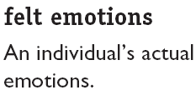
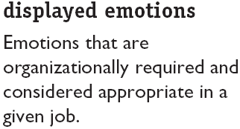
Felt versus Displayed Emotions

Slide 11
Culture and Emotion
Universality
  Ekman (1999) has found six emotions which are universally recognized and applicable
(Anger, Fear, Sadness, Happiness, Disgust and Surprise)
Physical responses
  Attached to the idea of primary emotions as innate is the notion that each emotion causes a detectable physical response in the body.
  These responses are often perceived as sensation in the body; for example:

Slide 12
Cont…
  Fear is felt as a heightened heartbeat, increased “flinch” response, and increased muscle tension.
  Anger, based on sensation, seems indistinguishable from fear.
  Happiness is often felt as an expansive or swelling feeling in the chest and the sensation of lightness or buoyancy, as if standing underwater.
  Sadness is often experienced as a feeling of tightness in the throat and eyes, and relaxation in the arms and legs.
  Shame can be felt as heat in the upper chest and face.
  Desire can be accompanied by a dry throat, heavy breathing, and increased heart rate.

Slide 13
cont…
Cultural specificity
  Human being are like a tabula rasa (clean tablet) on which society writes its script.
  In other words, culture and traditions, normative patterns and value-orientations are responsible for not only our personality development, but also appropriate social and emotional development.
  Each culture has a unique set of emotions and emotional responses; the emotions shown in a particular culture reflects the norms, values, practices, and language of that culture.

Slide 14
Cont…
Alexithymia – emotional disorder
  Some people have difficulty in expressing their emotions and understanding the emotions of others. Psychologists call this Alexithymia.
  People who suffer from alexithymia rarely cry and are often seen by others as bland and cold.
Relationship of gender with emotion
  A number of research finding supports the view that women are more emotional than men.
  (E.g. Broverman, Vogel, Broverman, Clarkson, & Tosenkrants, 1972; Widiger & Settle, 1987)

Slide 15
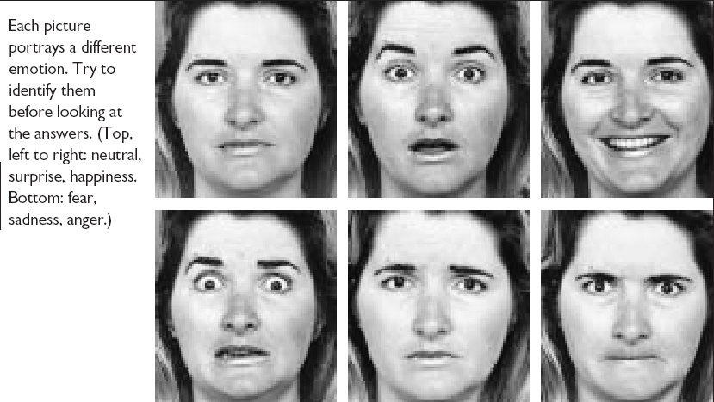
Facial Expressions Convey Emotions
6-1
E X H I B I T

Slide 16
ARE YOU EMOTIONALLY INTELLIGENT?
OR
YOU STILL THINK (not feel) THAT IQ MATTERS MORE THAN EQ

Slide 17
Before we move ahead please note that:
IQ means intelligence quotient
EQ means emotional quotient
EI means emotional intelligence
My website add is: www.eqindia.com

Slide 18
What is Emotional Intelligence (EI)?
The capacity for recognizing our own feelings and those of others, for motivating ourselves, and for managing emotions well in ourselves and in our relationships.
“Being nice”
Letting feelings
hang out”
a field in infancy
fast-growing
aspects harken to research of the 1940’s
Notes:
Based on Goleman’s book (1995), Emotional Intelligence
Daniel Goleman is a writer; not a researcher. As a writer he had the gift of explaining the research to others. He is also a psychologist.

Slide 19
What Exactly Is EQ
Emotional intelligence or Emotional Quotient is simply defined as:
knowing what feels good, what feels bad,
and how to get from bad to good.
Knowing your emotions and knowing emotion of others.
It refers to emotional management skills which provide competency to balance emotions and reason so as to maximize
long term happiness.

Slide 20
The Indian Perspective
“Emotional intelligence is the ability of an individual to appropriately and successfully respond to a vast variety of emotional inputs being elicited from inner self and immediate environment. Emotional intelligence constitutes three psychological dimensions such as emotional competency, emotional maturity and emotional sensitivity, which motivate an individual to recognize truthfully, interpret honestly and handle tactfully the dynamics of human behaviour”. (Dalip Singh 2003)

Slide 21
Are we giving EI education in schools /colleges
NO. Our educational system gives stress on IQ and not on EI. We are taught History, Hindi, English, Geography, Physics, anthropology, Botany, Computers, Medicine, Engineering etc.
We are not TAUGHT how to handle frustration, anxieties, stress, failure, depression, burnout, inferiority complexes, ego problems
We are not told to learn how to manage emotions i.e.; interaction, coordination, Adjustment, communication
We are expected to learn all these from our parents, peer group of other role models
At the later stages of our lives we are told to master emotional competencies to be successful.

Slide 22
IQ v/s EQ
(Intelligence Quotient v/s Emotional Quotient)
The research shows that IQ can help you to be successful to the extent of 20 percent only in life. The rest of 80 percent success depends on your EQ
20% IQ
80% EQ

Slide 23
WHAT IS “SUCCESS”
Is it your IQ: Exams passed, competitions cleared, percentage of marks in schools and colleges, academic qualifications etc
Earning fat salary, top positions in workplace, being rich and wealthy, powerful, dominating, being influential etc

Slide 24
OR SUCCESS IS SOMETHING ELSE
The word "success" is a relative term
Living a healthy and happy married life may be an indicator of success for some.
Reaching a top position in carrier may be an indicator of success for others
For some having a satisfying job life or personal satisfaction may be an indicator of success
Only the tangible achievements may not be indicators of success in life. Many a times non-tangible performance or achievements may be termed as successful.

Slide 25
GETS YOU
GETS YOU
HIRED
FIRED/PROMOTED
THE PROFESSIONAL SUCCESS

Slide 26
What experts say
Psychologists, Psychiatrists, Management consultants and Medical Doctors have been proving that there are personal characteristics called emotional intelligence which are responsible for the ways how we behave, how we feel, how we relate to others, how well we do at our jobs, and how healthy we are.

Slide 27
Cont...
Emotional Intelligence tendencies can result in being uncomfortable with other people, not being happy with your job, not succeeding at your job, and even being physically and psychologically unhealthy - with stress-related problems, or not having satisfactory interpersonal relations

Slide 28
The 5 Components of EI
Emotional Self-Awareness
Managing one’s own emotions
Using emotions to maximize intellectual processing
and decision-making
Developing empathy
The art of social relationships
(managing emotions in others)
Goleman’s Categories
Self-Awareness
Self-Regulation
Self-Motivation
Social Awareness
Social Skills
Notes:
Another way to express the framework comes directly from Goleman’s work (available from www.eiconsortium.org) is:
Personal Competence
Self-Awareness
emotional awareness
accurate self assessment
self-confidence
Self-Regulation
self control
trustworthiness
conscientiousness
adaptability
innovation
Self-Motivation
achievement drive
commitment
initiative
optimism
Social Competence
Social Awareness
empathy
service orientation
developing others
leveraging diversity
political awareness
Social Skills
influence
communication
leadership
change catalyst
conflict management
building bonds
collaboration and cooperation
team capabilities

Slide 29
Emotional self-awareness
The inability to notice our true feelings leaves us at their mercy.
People with greater certainty about their feelings are better pilots of their lives
and have a surer sense about how they feel about personal decisions.
Capacity for understanding one’s emotions, one’s strengths, and
one’s weakness.
Self-awareness
Notes:
Interesting to note; there are gender differences here. Females experience a greater range of intensity in emotions. More of these differences will be covered later, too.

Slide 30
Alexithymia;
when self awareness
is impoverished.
No words for
emotion
Difficulty in
distinguishing
between emotions
Impoverished capacity
for fantasy
Over-concern with
physical symptoms

Slide 31
Managing one’s own emotions
EI is like a smoke alarm--we’re not good at influencing whether a particular emotion will arise. EI tells us something is arising.
We do have tremendous individual variability in the degree to which we can consciously limit the duration of unpleasant emotions and the degree of influence over the behaviors which may arise.
Capacity for effectively managing one’s motives and
Regulating one’s behaviour
Self regulation

Slide 32
Out of control emotions
Impair reasoning (even smart people sometimes act stupidly)
May increase the likelihood that chronic emotional problems will result, (e.g., clinical depression or chronic anxiety or hostility)
Managing one’s own emotions
Notes:
Over time these will impact cardiovascular disease, the progression of diabetes; influence cancer onset or progression. Anxiety and cardiovascular disease predict subsequent cardiac events, the onset of hypertension, and even sudden death from fatal MI’s. Stress management reduces that risk and psychological intervention can make a difference. Having good emotional health influences good physical health.

Slide 33
Using emotions to maximize intellectual processing and decision making
As a person matures, emotions begin to shape and improve thinking by directing a person’s attention to important changes, (e.g., a child worries about his homework while continually watching TV. A teacher becomes concerned about a lesson that needs to be completed for the next day. The teacher moves on to complete the task before concern takes over enjoyment.
self motivation
Notes:
Mayer, J.D., and Salovey, P. (1995.) Emotional intelligence and the construction and regulation of feelings. Applied and Preventive Psychology, 4, 197-208.

Slide 34
Utilizing mild emotional swings to perform one’s options more effectively
“Gut feeling” can be used to effectively guide decisions--a neurological understanding of how unconscious and conscious gut feelings guide decisions, e.g., when prioritizing, emotions help move the decisions.
  Harness emotions to promote or hinder motivation. (Anxiety, hostility, sadness)
  Emotional swings to increase the accuracy of one’s perspective on future events.
Using emotions to maximize intellectual processing and decision making
Notes:
In neurobiological terms also referred to as “somatic markers.”

Slide 35
Developing empathy
Empathy is the ability to recognize another’s emotional state, which is very similar to what you are experiencing.
In research on married couples, empathy appears to include matching the physiological changes of the other person.
Capacity for understanding what others are saying and feeling
And why they feel and act as they do.
social
awareness

Slide 36
Developing empathy links to
Greater emotional stability
Greater interpersonal sensitivity
Better school performance
Developing empathy

Slide 37
The art of social relationships--managing emotions in others
To excel at people skills means having and using the competencies to be an effective friend, negotiator, and leader. One should be able to guide an interaction, inspire others, make others comfortable in social situations, and influence and persuade others.
social
skills
Notes:
Quickly relate the social relationships and managing emotions in others topic to Office of Personnel Management Executive Core Qualifications (ECQ’s) and to Army Values as exemplified by FM 22-100; leadership; duty; respect; selfless service; honesty; integrity; personal courage. This ground will be covered more thoroughly in a later slide dealing with organizations and EI.

Slide 38
The subtle and complex abilities which underlie people skills
Being attuned to others’ emotions
Promoting comfort in others through the proper use of display rules
Using own emotional display to establish a sense of rapport
The art of social relationships--managing emotions in others
Notes:
Making criticism constructive is an example.
See Weisinger, H. Ph.D. (1998.) Emotional intelligence at work. San Francisco: Jossey-Bass.

Slide 39
Goleman’s Emotional Intelligence Model (1995)
Emotional intelligence
Personal competence
Social competence
Self awareness
Self regulation
Motivation
Empathy
Social Skills

Slide 40
Thank you

